Slide 1
Identifying and Modeling Perturbed Networks in Cancer through Statistical and Constraint-based Analysis
James Eddy
Department of Bioengineering – Preliminary Exam
University of Illinois, Urbana-Champaign
May 24, 2011

Slide 2
Background & Significance
Glioblastoma multiforme (GBM)
Systems biology approaches to cancer research
In silico modeling of metabolism in GBM with biochemical reaction networks

Slide 3
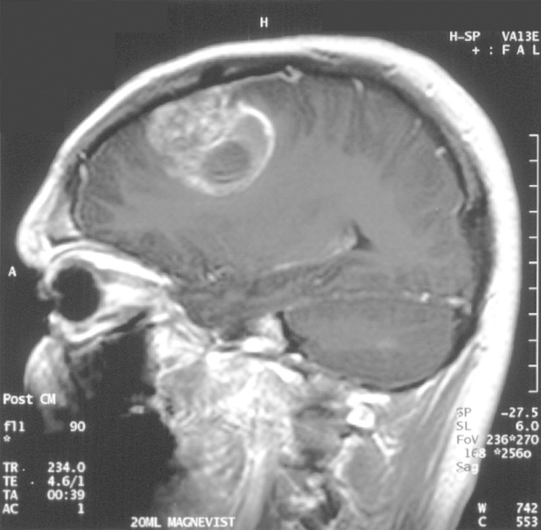
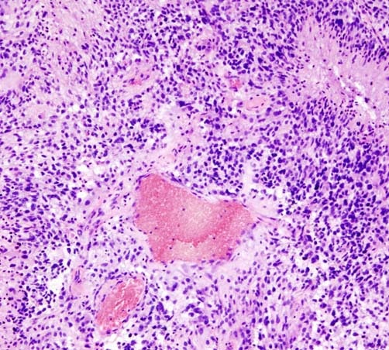
Glioblastoma multiforme: most lethal brain cancer
Primary CNS tumors
Diagnosed in ~22,000 annually
1.4% of diagnosed cancers
2.3% of cancer related deaths
Gliomas (glial cell tumors)
80% of adult brain tumors
astrocytomas are most common type
Glioblastoma multiforme (GBM)
Grade IV astrocytoma
Poor survival, no effective treatment
http://cancergenome.nih.gov/cancersselected/glioblastomamultiforme
1

Slide 4
Cancer is a highly complex disease
At the genetic level: synergistic interactions among genetic lesions
Genetic effects convoluted with changes in gene/protein expression, epigenetics, & tissue-level interactions
Edelman, L.B., Eddy, J.A., Price, N.D. WIRES Syst Biol Med (2010)
2
Notes:
Cancer is complex, malignancy arises from convolution of numerous biological phenomena on multiple scales
Does not arise from any single mutation, but from the net affect of multiple interacting abberant components
Genetic effects convoluted with various other changes, each frequently involving large numbers of interacting agents
Confounding factor: distribution of mutations differs in each GBM patient

Slide 5
Cancer is a highly complex disease
At the genetic level: synergistic interactions among genetic lesions
Genetic effects convoluted with changes in gene/protein expression, epigenetics, & tissue-level interactions
Different sets of mutations appear in every GBM patient
Edelman, L.B., Eddy, J.A., Price, N.D. WIRES Syst Biol Med (2010)
2
Notes:
Cancer is complex, malignancy arises from convolution of numerous biological phenomena on multiple scales
Does not arise from any single mutation, but from the net affect of multiple interacting abberant components
Confounding factor: distribution of mutations differs in each GBM patient

Slide 6
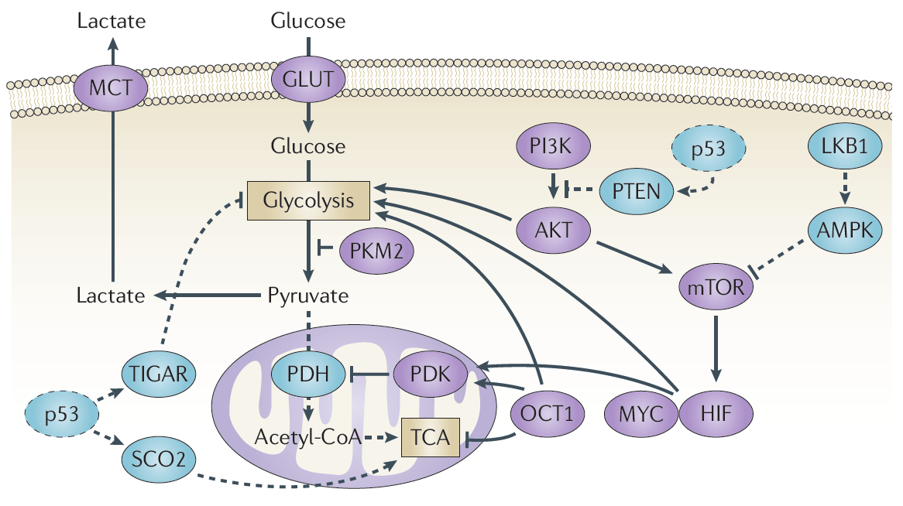
Altered metabolism critical in cancer development
Metabolism relatively well-understood process, highly perturbed in oncogenesis
Metabolic hallmarks of cancer
Warburg effect
Increased biosynthesis of macromolecures
Tighter redox maintenance
Brain most metabolically active organ—promising focus for GBM
Metabolic enzymes and pathways implicated in cancer, even targeted in chemotherapy; for many mutations, causal relationship to malignant phenotypes often unknown
Cairns, R.A. et al. Nat Rev Cancer (2011); Mo, M.L. & Palsson, B.Ø. Trends Biotechnol (2009)
3
Notes:
One example of a complex process in cancer is metabolism
Metabolism is well understood process, highly perturbed in oncogenesis
Can identify (and target) individual mutations and altered pathways, but difficult to understand causal relationtionship to malignant phenotypes
Metabolic hallmarks of cancer: decreased aerobic respiration, increased glycolysis, increased phospholipid production
Brain is most metabolically active organ, making this type of biochemical network a key focus in GBM

Slide 7

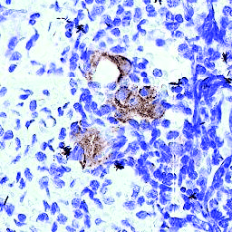
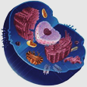
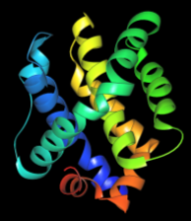
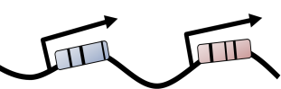
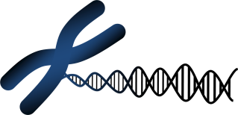
Systems biology enables advanced cancer research
Reductionist biology: provide a “parts list” for biological systems
Organism
Organs & Tissues
Cells
DNA structure/sequence, genes, proteins, etc.
4
Notes:
Our understanding of metabolism and other processes in cancer is largely owed to monumental advances in molecular and cellular biology, which have provided an increasingly detailed portrait of human biology
Reductionist biology has provided valuable info for components in cancer and other diseases; difficult to comprehend beyond a handful
Systems biology uses integrative approach to understand overall effects; describe interactions mathematically to establish computable models

Slide 8
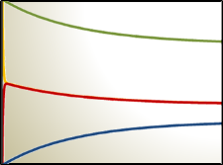
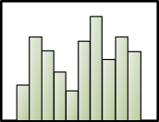
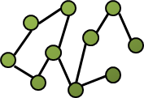
Systems biology enables advanced cancer research
Reductionist biology: provide a “parts list” for biological systems
Organism
Organs & Tissues
Phenotypes
Cells
Networks
Integrative biology: interactions among all components analyzed to determine global effects
DNA structure/sequence, genes, proteins, etc.
4
Notes:
Our understanding of metabolism and other processes in cancer is largely owed to monumental advances in molecular and cellular biology, which have provided an increasingly detailed portrait of human biology
Reductionist biology has provided valuable info for components in cancer and other diseases; difficult to comprehend beyond a handful
Systems biology uses integrative approach to understand overall effects; describe interactions mathematically to establish computable models

Slide 9


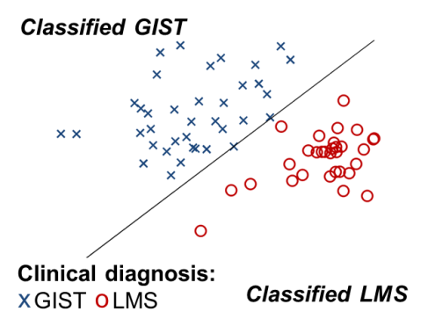
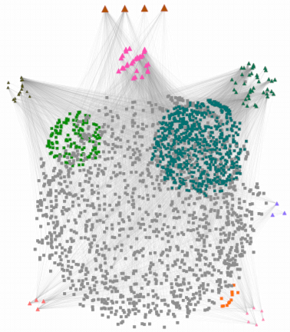
In silico modeling: statistical and mechanistic approaches
Normal cell
Tumor cell
Statistical models and inferred networks derived from high-throughput data
5
Notes:
In silico models of cancer include: (1) statistical models inferred from high-throughput data, (2) biochemical reaction networks
Both represent systems level analysis of many individual components
Statistical approaches evaluate expression for thousands of genes to establish models for classification, or to infer regulatory networks that can predict expression
Biochemical reaction networks
- Mechanistic, based on physical rules
- Constructed from databases & literature; genome is key
- Well-established procedures for reconstruction and analysis
BRNs can be used for:
- predictive modeling and simulation
- platform for anlysis of high throughput data

Slide 10
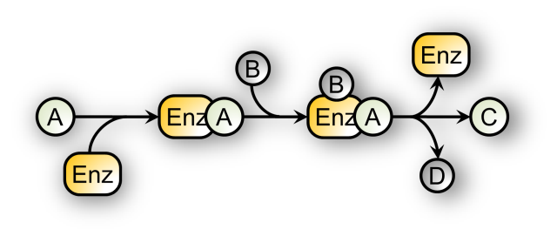
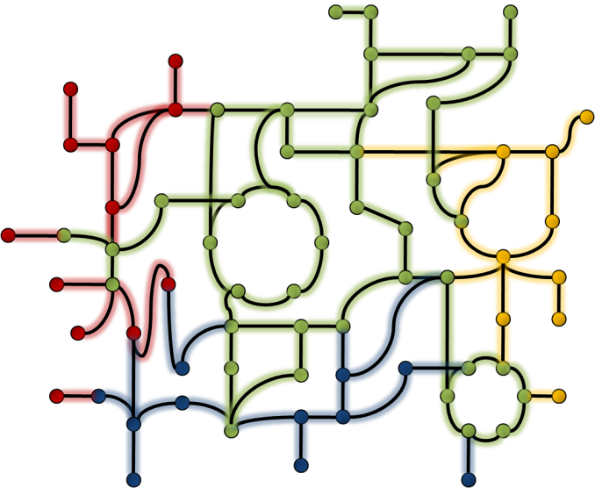
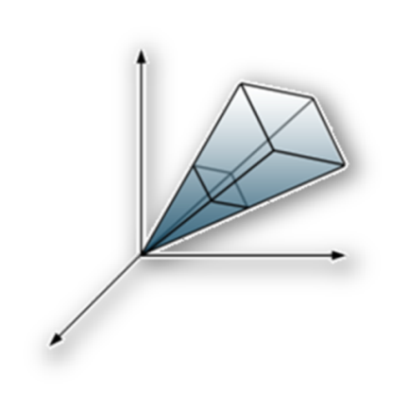
In silico modeling: statistical and mechanistic approaches
Normal cell
Tumor cell
Statistical models and inferred networks derived from high-throughput data
Biochemical reaction networks based on detailed mechanistic data
5
Notes:
At the molecular level: in silico models of cancer include: (1) statistical models inferred from high-throughput data, (2) biochemical reaction networks
Both represent systems level analysis of many individual components
Statistical approaches evaluate expression for thousands of genes to establish models for classification, or to infer regulatory networks that can predict expression
Biochemical reaction networks
- Mechanistic, based on physical rules
- Constructed from databases & literature; genome is key
- Well-established procedures for reconstruction and analysis
BRNs can be used for:
- predictive modeling and simulation
- platform for anlysis of high throughput data

Slide 11

In silico modeling: statistical and mechanistic approaches
Normal cell
Tumor cell
Statistical models and inferred networks derived from high-throughput data
Biochemical reaction networks based on detailed mechanistic data
Integrating both approaches provides mechanistic context for high-throughput data
5
Notes:
In silico models of cancer include: (1) statistical models inferred from high-throughput data, (2) biochemical reaction networks
Both represent systems level analysis of many individual components
Statistical approaches evaluate expression for thousands of genes to establish models for classification, or to infer regulatory networks that can predict expression
Biochemical reaction networks
- Mechanistic, based on physical rules
- Constructed from databases & literature; genome is key
- Well-established procedures for reconstruction and analysis
BRNs can be used for:
- predictive modeling and simulation
- platform for anlysis of high throughput data

Slide 12
Specific Aims
Specific Aim 1: Develop tools for network-based analysis of high-throughput expression data in cancer and other diseases
Specific Aim 2: Reconstruct the first genome-scale metabolic network for glioblastoma multiforme
Specific Aim 3: Provide mechanistic and functional context for high-throughput mutation and expression data in GBM using the metabolic model
6

Slide 13
Specific Aim 1: Develop tools for network-based analysis of high-throughput expression data in cancer and other diseases
Analyzing gene expression in the context of biological networks
Emphasis on relative expression of genes and networks
Methods can be applied to mechanistic pathways in GBM

Slide 14
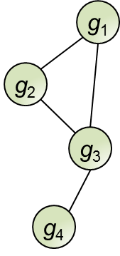
Genes interact in biological networks to cause disease
Diseased cells arise from perturbed biological networks—net effect of interactions among multiple molecular agents
Previous network analyses do not account for combinatorial interactions among genes
7
Notes:
Diseased cells arise from interactions among molecular agents in networks
Previous network analyes treat networks wholistically, do not account for combinatorial interactions
Findings with the TSP algorithm show that even relationships among pairs of genes can be informative; relative expression reversal

Slide 15
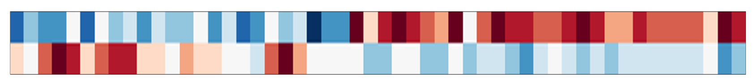
Genes interact in biological networks to cause disease
Diseased cells arise from perturbed biological networks—net effect of interactions among multiple molecular agents
Previous network analyses do not account for combinatorial interactions among genes
Even relationships among pairs of genes can be informative for disease classification
Top-scoring pair (TSP):
Phenotype A
Phenotype B
g₁
g₂
Eddy, J.A. et al. TCRT (2010); Price, N.D. et al. PNAS (2007)
7
Notes:
Diseased cells arise from interactions among molecular agents in networks
Previous network analyes treat networks wholistically, do not account for combinatorial interactions
Findings with the TSP algorithm show that even relationships among pairs of genes can be informative; relative expression reversal

Slide 16
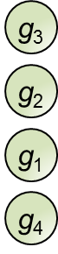
Assessing combinatorial interactions in networks
Differential rank conservation (DIRAC) uses relative expression values of genes to quantify biological networks
Measures how network rankings differ within and between disease phenotypes
Highest Expression
Lowest Expression
Eddy, J.A. et al. PLoS Comp Biol (2010)
8
Notes:
Developed a new approach called DIRAC that uses relative expression values of genes to quantify networks
DIRAC extends the relative expression reversal concept to networks: pairwise comparisons
Measures how rankings differ within and between different phenotypes and disease states

Slide 17
Assessing combinatorial interactions in networks
Differential rank conservation (DIRAC) uses relative expression values of genes to quantify biological networks
Measures how network rankings differ within and between disease phenotypes
g₃ > g₂
g₃ > g₁
g₃ > g₄
Highest Expression
Extends relative expression reversal concept to networks: rankings enumerated by pairwise comparisons
g₂ > g₁
g₂ > g₄
Lowest Expression
g₁ > g₄
Eddy, J.A. et al. PLoS Comp Biol (2010)
8
Notes:
Developed a new approach called DIRAC that uses relative expression values of genes to quantify networks
DIRAC extends the relative expression reversal concept to networks: pairwise comparisons
Measures how rankings differ within and between different phenotypes and disease states

Slide 18
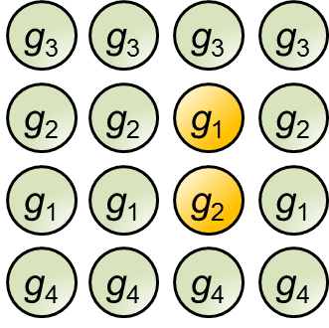
DIRAC identifies tightly & loosely regulated networks
Samples of Phenotype A:
Highest conservation
Genes participating in network 1, ranked highest (top) to lowest expression (bottom)
Lowest conservation
9
Notes:
At population level, DIRAC contrasts two scenarios:
- Network is consistently ranked across samples of the same phenotype: tightly regulated (mu_R ~ 1.0)
- Network ranking is varied from sample to sample: loosely regulated (mu_R ~ 0.5)

Slide 19
DIRAC identifies tightly & loosely regulated networks
Samples of Phenotype A:
tightly regulated network
Highest conservation
Genes participating in network 1, ranked highest (top) to lowest expression (bottom)
µ_{R} ~ 1.0
Lowest conservation
9
Notes:
At population level, DIRAC contrasts two scenarios:
- Network is consistently ranked across samples of the same phenotype: tightly regulated (mu_R ~ 1.0)
- Network ranking is varied from sample to sample: loosely regulated (mu_R ~ 0.5)

Slide 20
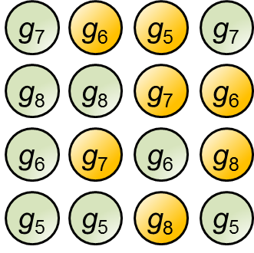
DIRAC identifies tightly & loosely regulated networks
Samples of Phenotype A:
tightly regulated network
Highest conservation
Genes participating in network 1, ranked highest (top) to lowest expression (bottom)
µ_{R} ~ 1.0
Genes participating in network 2
Lowest conservation
9
Notes:
At population level, DIRAC contrasts two scenarios:
- Network is consistently ranked across samples of the same phenotype: tightly regulated (mu_R ~ 1.0)
- Network ranking is varied from sample to sample: loosely regulated (mu_R ~ 0.5)

Slide 21
DIRAC identifies tightly & loosely regulated networks
Samples of Phenotype A:
tightly regulated network
Highest conservation
Genes participating in network 1, ranked highest (top) to lowest expression (bottom)
µ_{R} ~ 1.0
loosely regulated network
µ_{R} ~ 0.5
Genes participating in network 2
Lowest conservation
9
Notes:
At population level, DIRAC contrasts two scenarios:
- Network is consistently ranked across samples of the same phenotype: tightly regulated (mu_R ~ 1.0)
- Network ranking is varied from sample to sample: loosely regulated (mu_R ~ 0.5)

Slide 22
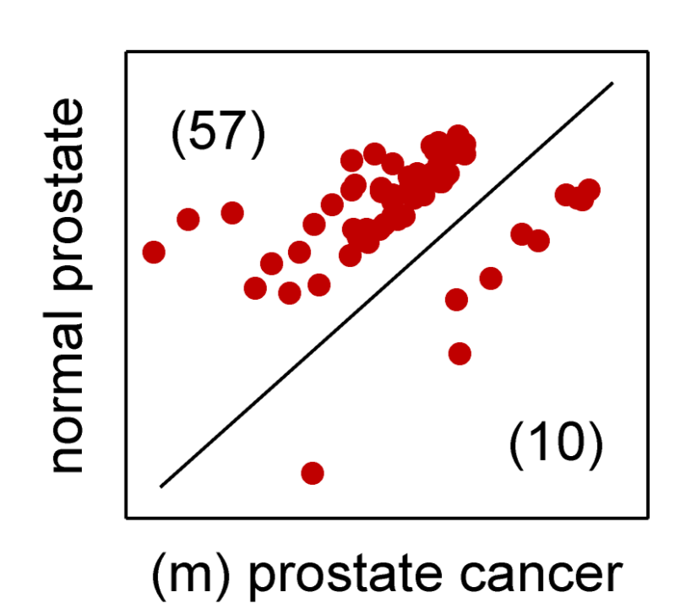

Networks exhibit differential regulation between states
FIBRINOLYSIS network
Rank conservation (µ_{R}) in normal prostate: 0.891
Rank conservation (µ_{R}) in metastatic prostate cancer: 0.736
Difference in rank conservation: 0.156
P-value < 0.001
10
Notes:
An informative application of this measure is to identify networks tightly regulated in one phenotype, but not in another
The FIBRINOLYSIS network is more tightly regulated in normal prostate than in metastatic prostate cancer (significant difference)
Inspecting all networks with significant difference in conservation shows an overwhelming majority are more tightly regulated in normal

Slide 23
Networks exhibit differential regulation between states
FIBRINOLYSIS network
Rank conservation (µ_{R}) in normal prostate: 0.891
Rank conservation (µ_{R}) in metastatic prostate cancer: 0.736
Difference in rank conservation: 0.156
P-value < 0.001
All networks with significant difference in µ_{R} (P-value < 0.05)
10
Notes:
An informative application of this measure is to identify networks tightly regulated in one phenotype, but not in another
The FIBRINOLYSIS network is more tightly regulated in normal prostate than in metastatic prostate cancer (significant difference)
Inspecting all networks with significant difference in conservation shows an overwhelming majority are more tightly regulated in normal

Slide 24
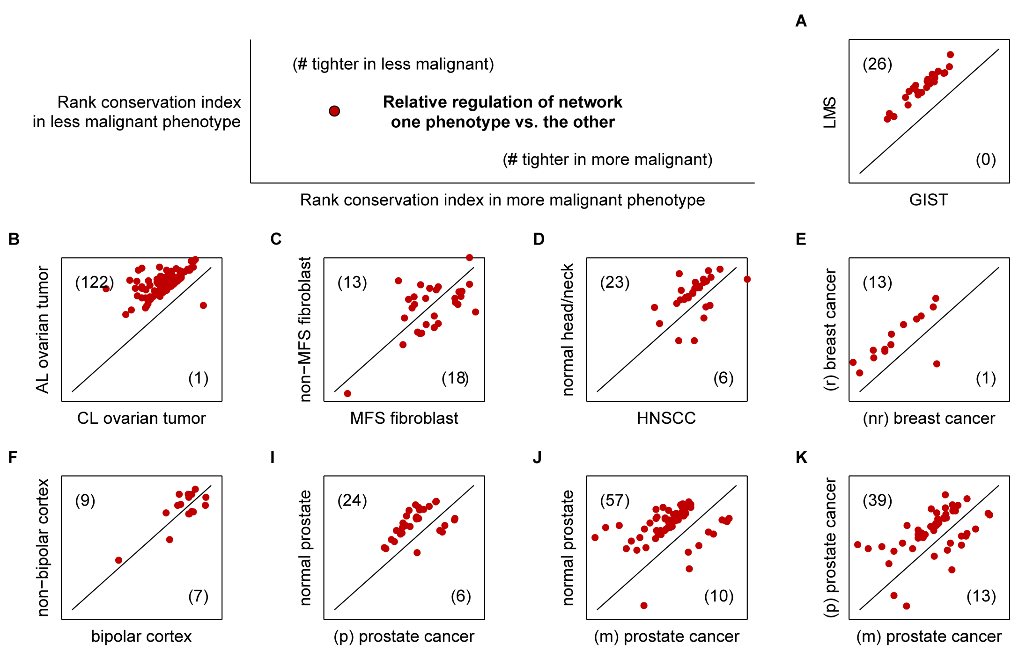
Networks tend to be degregulated in disase
11
Notes:
Extending this analysis to a number of different binary phenotype comparisons, trend persists
Only exception is Marfan syndrome, which had a very limited number of genes
Concept of greater variation, looser regulation with increased malignancy—especially in cancer—is somewhat intuitive, but DIRAC provides quantification

Slide 25
Networks tend to be deregulated in disase
11
Notes:
Extending this analysis to a number of different binary phenotype comparisons, trend persists
Only exception is Marfan syndrome, which had a very limited number of genes
Concept of greater variation, looser regulation with increased malignancy—especially in cancer—is somewhat intuitive, but DIRAC provides quantification

Slide 26
Average network conservation estimates global regulation
Network name. | Num. genes | µ_{R}
GS | 6 | 1.000
FOSB | 4 | 0.981
AKAP13 | 7 | 0.955
AGPCR | 11 | 0.955
RNA | 8 | 0.948
CACAM | 12 | 0.947
NDKDYNAMIN | 17 | 0.946
ETC | 8 | 0.946
SET | 11 | 0.945
ALTERNATIVE | 8 | 0.847
ALK | 34 | 0.845
LAIR | 14 | 0.844
PITX2 | 16 | 0.840
METHIONINE | 5 | 0.839
IL5 | 10 | 0.833
STEM | 15 | 0.829
ION | 5 | 0.806
CYTOKINE | 21 | 0.805
IL18 | 6 | 0.763
LEPTIN | 8 | 0.728
Rank conservation of networks in normal prostate samples
…
…
…
12
Notes:
Averaging rank conservation of all networks in a phenotype gives a sense of global network regulation for that phenotype

Slide 27
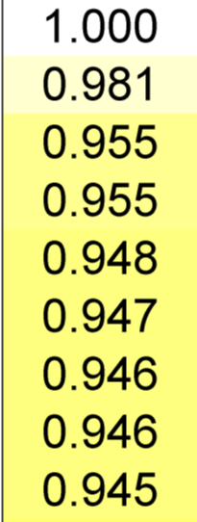
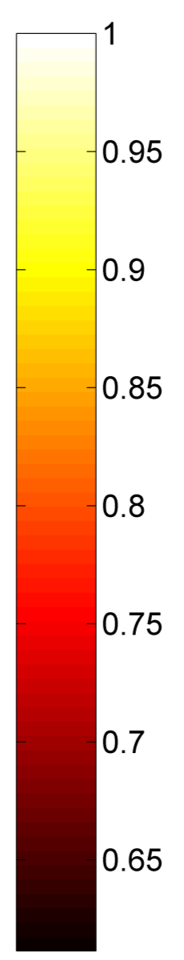
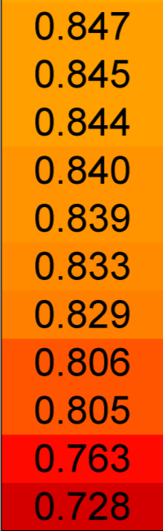
Average network conservation estimates global regulation
Network name. | Num. genes | µ_{R}
GS | 6 | 1.000
FOSB | 4 | 0.981
AKAP13 | 7 | 0.955
AGPCR | 11 | 0.955
RNA | 8 | 0.948
CACAM | 12 | 0.947
NDKDYNAMIN | 17 | 0.946
ETC | 8 | 0.946
SET | 11 | 0.945
ALTERNATIVE | 8 | 0.847
ALK | 34 | 0.845
LAIR | 14 | 0.844
PITX2 | 16 | 0.840
METHIONINE | 5 | 0.839
IL5 | 10 | 0.833
STEM | 15 | 0.829
ION | 5 | 0.806
CYTOKINE | 21 | 0.805
IL18 | 6 | 0.763
LEPTIN | 8 | 0.728
Average rank conservation across all 248 networks: 0.903
…
…
…
12
Notes:
Averaging rank conservation of all networks in a phenotype gives a sense of global network regulation for that phenotype

Slide 28
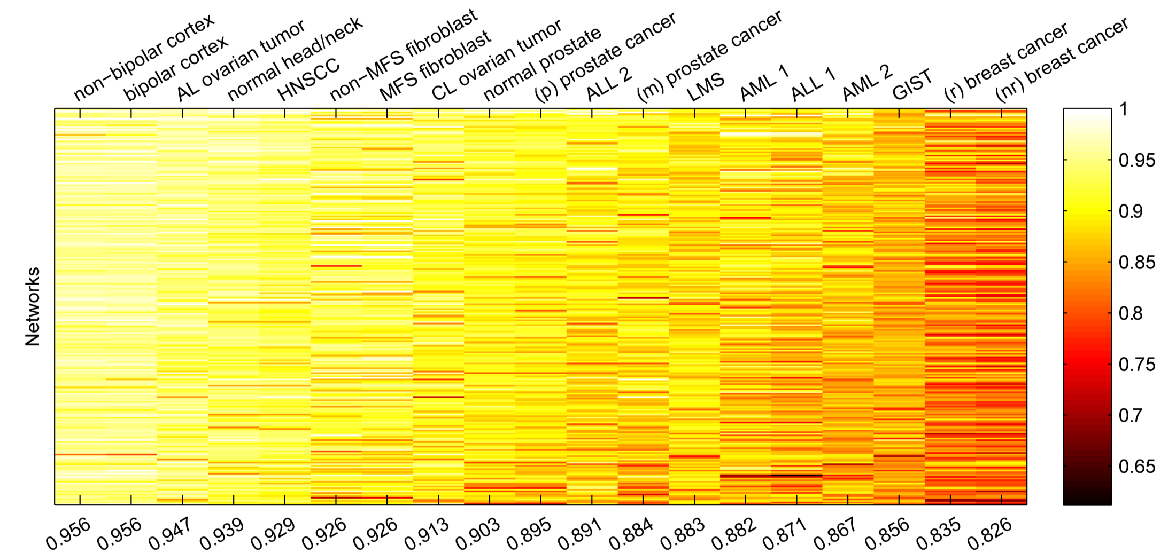
Trend of lower conservation with malignancy persists
Highest rank conservation
Lowest rank conservation
Tighter network regulation: normal prostate
Looser network regulation: primary prostate cancer
Loosest network regulation: metastatic prostate cancer
13
Notes:
Even from a more coarse-grained perspective, trend of looser regulation (more shuffling of networks between samples) seems to persist
Example of prostate cancer
Example of breast cancer

Slide 29
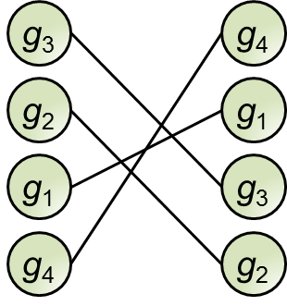
DIRAC identifies variably expressed networks
shuffled network ranking between phenotypes
Phenotype A
Phenotype B
14
Notes:
At the sample level, DIRAC can identify networks that are consistently shuffled between phenotypes
Define a rank difference score: positive if a sample looks like first phenotype; negative otherwise
Strong signal for all networks; identify network with best classification accuracy

Slide 30
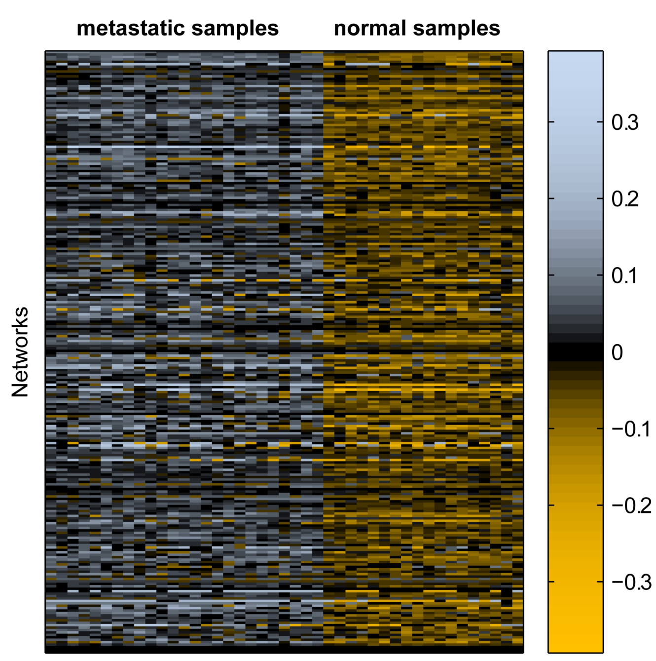
DIRAC identifies variably expressed networks
shuffled network ranking between phenotypes
Phenotype A
Phenotype B
Samples tend to match more closely to their true respective phenotypes; enables classification based on network ranking
14
Notes:
At the sample level, DIRAC can identify networks that are consistently shuffled between phenotypes
Define a rank difference score: positive if a sample looks like first phenotype; negative otherwise
Strong signal for all networks; identify network with best classification accuracy

Slide 31
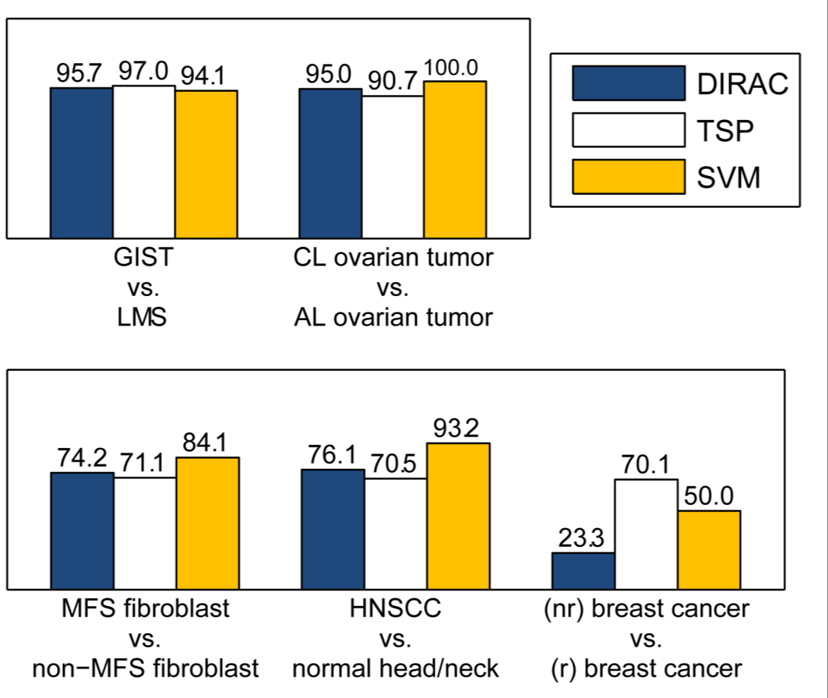
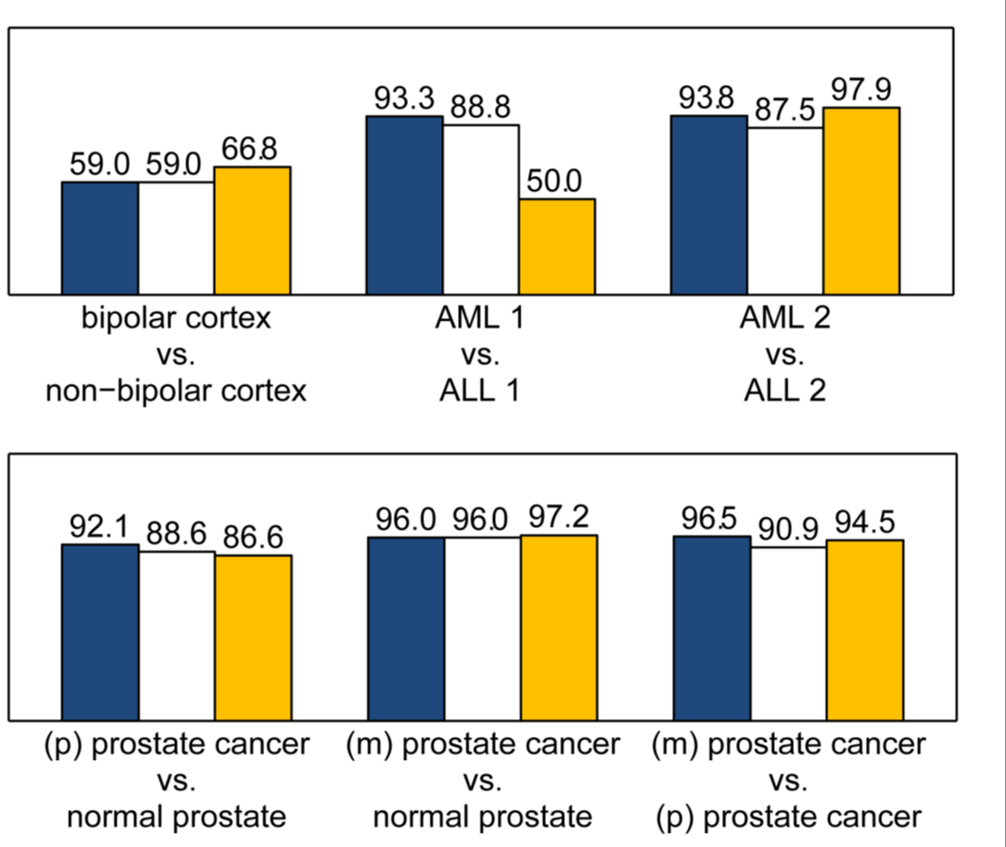
DIRAC classification is comparable to other methods
Cross validation accuracies
15
Notes:
DIRAC classification performs well when other methods do well; when DIRAC fails, so do others
Predictive accuracy becomes a strong measure for the validity of the perturbed network being a reproducible hallmark of the disease phenotype
Extensions of DIRAC aim to improve accuracy in poor cases

Slide 32
DIRAC offers several advantageous features
Independent of data normalization
Independent of genes/proteins outside of network
Can show massive/complete perturbations
Unlike Fischer’s exact test (e.g., GO enrichment)
Measures “shuffling” of network in terms of the hierarchy of expression of components
Distinct from enrichment or GSEA
Provides distinct mathematical classifier to yield measurement of predictive accuracy on test data
Stronger than p-value for determining signal
Code for the method can be found at our website:
http://www.igb.uiuc.edu/labs/price/downloads_tmp.html
16

Slide 33
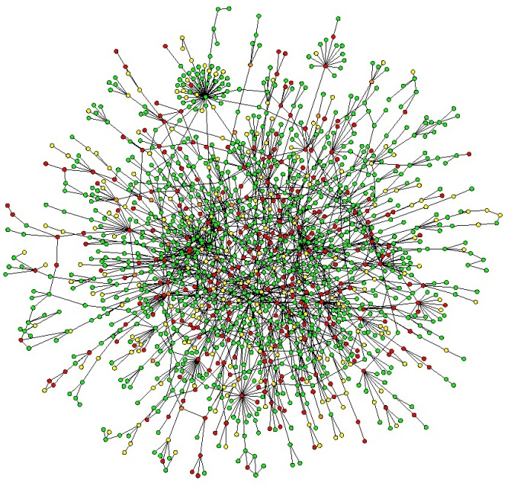
Learning new networks to improve DIRAC performance
Interaction networks advantageous over a priori defined pathways
17
Notes:
Networks defined a priori in pathway databases may not be representative of functioining sets of genes in a particular phenotype
Protein-protein interaction networks clearly dilineate interacting members of networks, restricting search for modifications; translates well to reconstructed network
Using PPI data obtained from BioGRID and HPRD databases, link communities method was use to define subnetworks
Within cross-validation (to avoid overfitting), SFFS used to adaptively grow or shrink networks to improve performance (accuracy)
Even though seed subnetworks may not be constructed specific to phenotypes, learned networks are more representative of differences between phenotypes

Slide 34
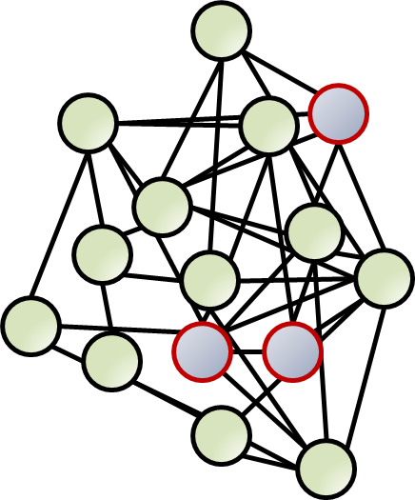
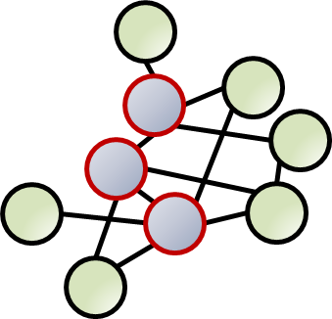
Learning new networks to improve DIRAC performance
Interaction networks advantageous over a priori defined pathways
Link communities clustering used to define subnetworks in protein-protein interaction network data
Sequential forward floating search algorithm to adaptively grow and shrink subnetworks
17
Notes:
Networks defined a priori in pathway databases may not be representative of functioining sets of genes in a particular phenotype
Protein-protein interaction networks clearly dilineate interacting members of networks, restricting search for modifications; translates well to reconstructed network
Using PPI data obtained from BioGRID and HPRD databases, link communities method was use to define subnetworks
Within cross-validation (to avoid overfitting), SFFS used to adaptively grow or shrink networks to improve performance (accuracy)
Even though seed subnetworks may not be constructed specific to phenotypes, learned networks are more representative of differences between phenotypes

Slide 35
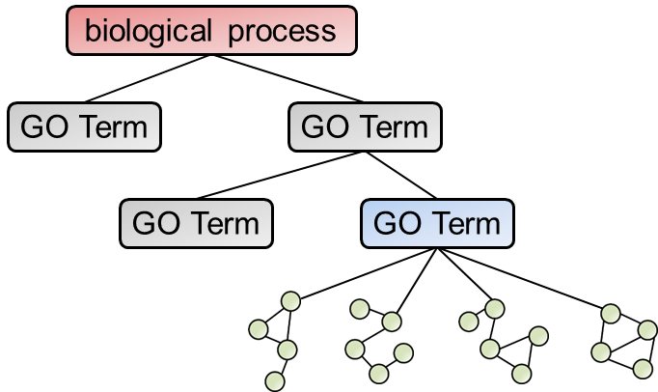
Comparative analysis of network families with RXA
Multiple networks often perturbed in cancer; analogous to network-level analysis of gene expression, can analyze “networks of networks”
“Network families” defined by Gene Ontology (GO) structure: “children” of the same GO term
18
Notes:
Numerous studies have found that multiple networks are perturbed in cancer; analyzing “networks of networks” to examine how network activity changes relative to others may yield further insight
We define network families based on structure of Gene Ontology, where members are “children” of the same GO term
Treating networks within families as variables instead of genes (network expression can be calculated as mean of gene expression), apply previously developed RXA algorithms

Slide 36
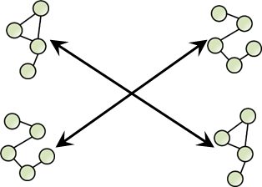
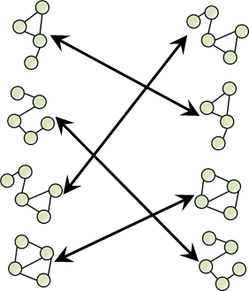
Comparative analysis of network families with RXA
Multiple networks often perturbed in cancer; analogous to network-level analysis of gene expression, can analyze “networks of networks”
NF-RXA: network families analyzed with existing RXA algorithms, treating network expression levels as variables instead of genes
Phenotype A
Phenotype B
NF-TSP
Phenotype A
Phenotype B
“Network families” defined by Gene Ontology (GO) structure: “children” of the same GO term
NF-DIRAC
18
Notes:
Numerous studies have found that multiple networks are perturbed in cancer; analyzing “networks of networks” to examine how network activity changes relative to others may yield further insight
We define network families based on structure of Gene Ontology, where members are “children” of the same GO term:
Treating networks within families as variables instead of genes (network expression can be calculated as mean of gene expression), apply previously developed RXA algorithms
Example
- applying TSP to GO terms w/out restricting to families yields following top pair for breast cancer:
-- molybdenum ion binding
-- positive regulation of follicle-stimulating hormone secretion
- restricted to GO terms in the same family:
-- insuline-like growth factor receptor binding
-- transforming growth factor beta receptor binding

Slide 37


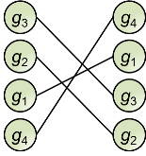
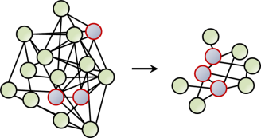

Summary of Specific Aim 1
Accomplished: Developed DIRAC, a novel technique for identifying and measuring network-level perturbations based on relative expression; published in PLoS Computational Biology
Next steps: Completing development of two additional network expression analysis tools for studying interaction-based subnetworks and comparing multiple related networks
Tools will be available as part of software package Adaptive Unified Relative Expression Analysis (AUREA), being developed in collaboration with John Earls
19
Notes:
DIRAC is a novel technique for identifying and measuring network-level perturbations based on relative expression
identified networks that are tightly and loosely regulated
observed strong trend of network deregulation in disease
identified variably expressed networks that represent robust differences between disease states

Slide 38
Specific Aim 2: Reconstruct the first genome-scale metabolic network for glioblastoma multiforme
Combining GBM-specific expression data with generic human metabolic model to determine active network
Refining and validating metabolic model—comparing simulations to experimental measurements

Slide 39
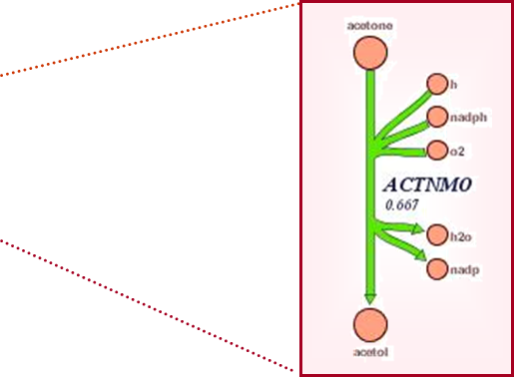
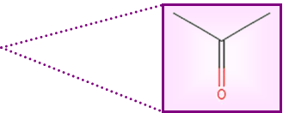
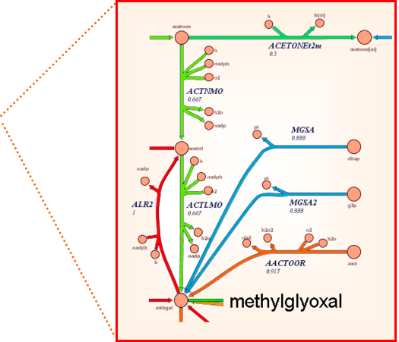
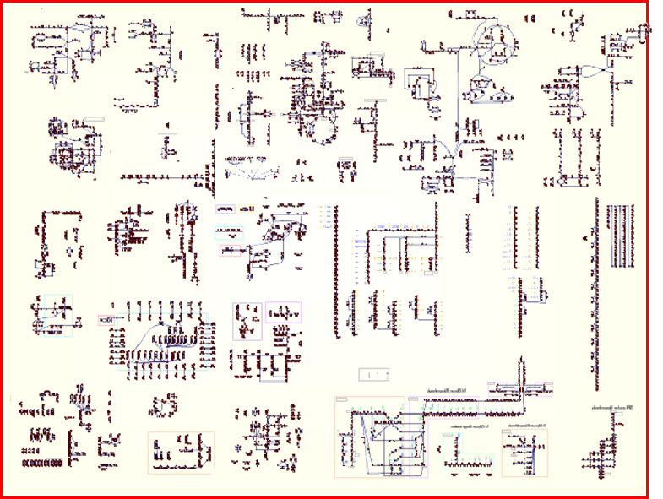
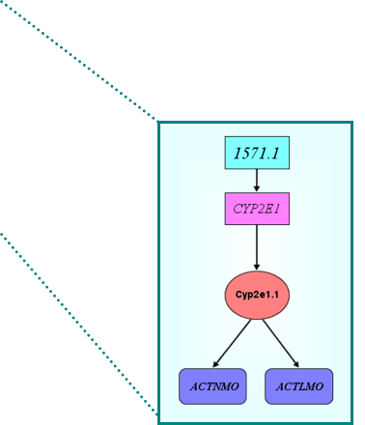
Human Recon 1 represents a global knowledgebase
Global metabolic map comprehensively represents known reactions in human cells
Compounds (2,712)
Reactions (3,311)
Pathways (98)
Genes (1,496)
Transcripts (1,905)
Proteins (2,004)
Compartments (7)
Duarte, N.C. et al. PNAS (2007); Systems Biology lecture slides, B.Ø. Palsson, UCSD
20
Notes:
Studies had previously modeled human metabolism on smaller scales (red blood cell, mitochondria); reconstruction of global metabolic network signified a major milestone in human systems biology
Human Recon 1 represents all known metabolic reactions encoded by the human genome
Sense of scope given by network statistics

Slide 40
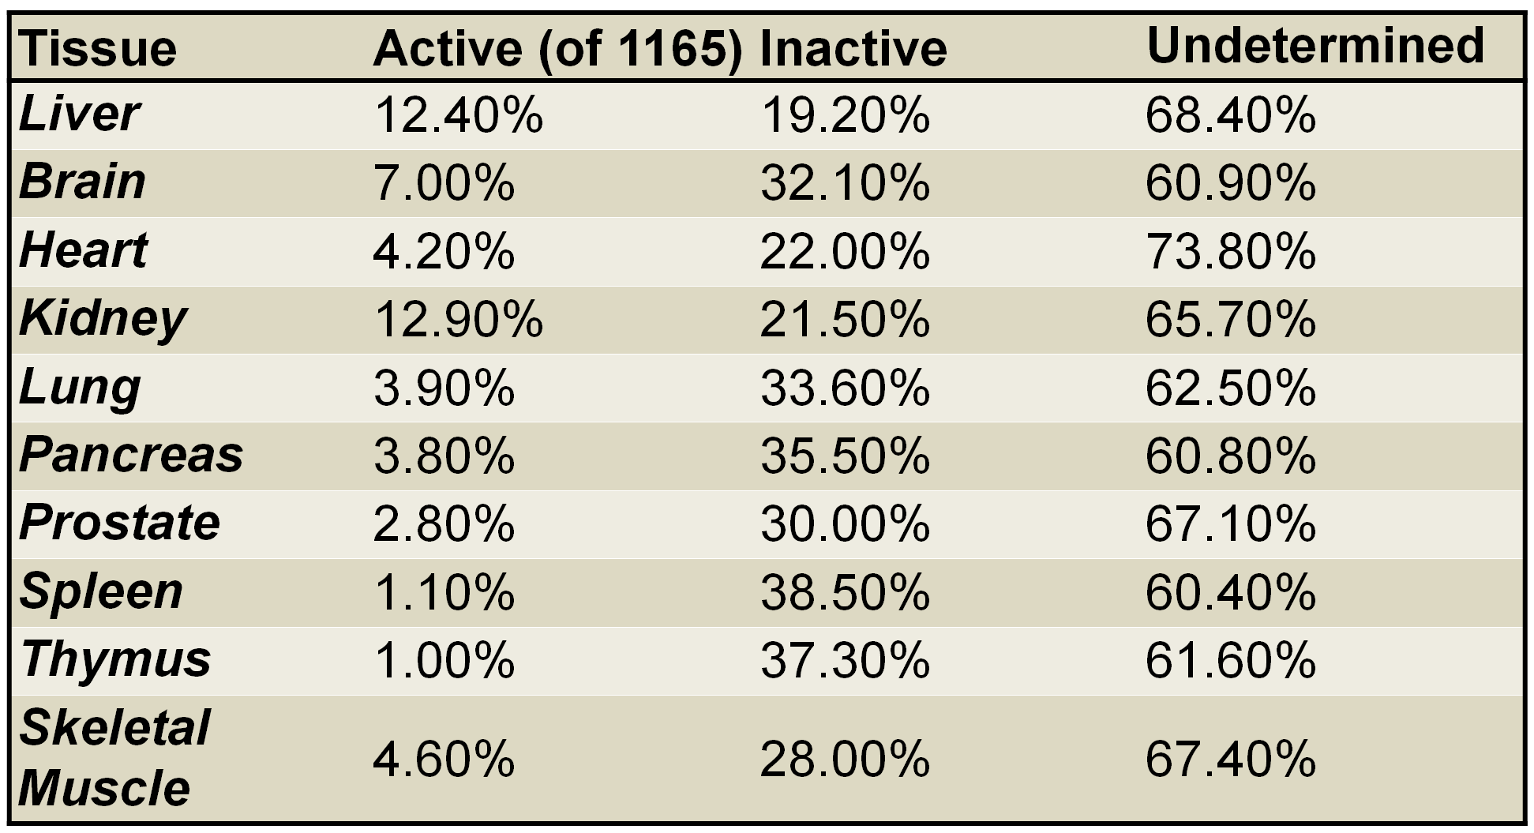
Metabolic activity varies between tissue and cell types
Only a subset of metabolism active in a particular cell or tissue
Shlomi, T. et al. Nat Biotechnol (2008)
21
Notes:
Study published in Nature Biotech estimated that only a limited subset of the full metabolic range is active in any specific tissue type
Recon 1 not accurate representation of metabolism in GBM
To identify this subset in GBM, we can begin with the full generic model and systematically prune reactions lacking evidence

Slide 41
Metabolic activity varies between tissue and cell types
Only a subset of metabolism active in a particular cell or tissue
Tissue- & cell-type expression data can be used to prune generic model (Human Recon 1) to identify the specific metabolic network
Shlomi, T. et al. Nat Biotechnol (2008)
21
Notes:
Study published in Nature Biotech estimated that only a limited subset of the full metabolic range is active in any specific tissue type
To identify this subset in GBM, we can begin with the full generic model and systematically prune reactions lacking evidence

Slide 42
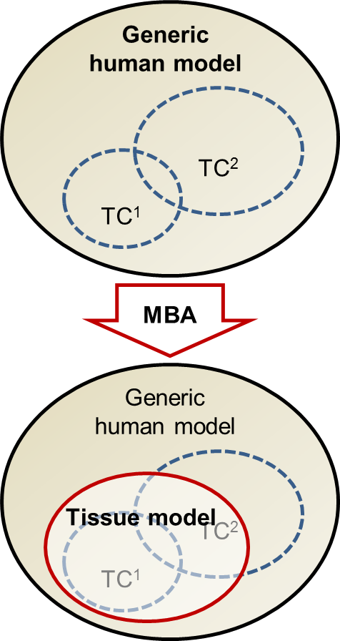
Global to tissue-specific metabolic networks with MBA
Model building algorithm (MBA) developed by Jerby et al. to reconstruct liver-specific metabolic network
Define tissue-specific cores
TC¹: high-confidence reactions; protein expression data for U-87 MG cell lines from Human Protein Atlas (HPA)
TC²: moderate-confidence reactions; gene expression data for U-87 and GBM samples from Gene Expression Omnibus (GEO)
Starting with Human Recon 1, sequentially remove reactions such that
All reactions in TC¹ remain active
Active reactions in TC² are maximized
Non-core reactions are minimized
Jerby, L. et al. Mol Syst Biol (2010)
22
Notes:
MBA developed in the groups of Eytan Ruppin and Tomer Shlomi (Tel Aviv) to reconstruct metabolic network specific to the liver
Based on two tissue-specific cores:
- TC1, high-confidence; in our case, protein expression for U-87 from HPA
- TC2, moderate-confidence; for GBM, gene expression from GEO
Since we’re using U-87 cell lines for the primary source of evidence to reconstruct the network, the model in effect becomes specific to U-87
Goal is to remove reactions, ensuring that all TC1 reactions must remain activateable, maximize TC2 reactions, and minimize others

Slide 43
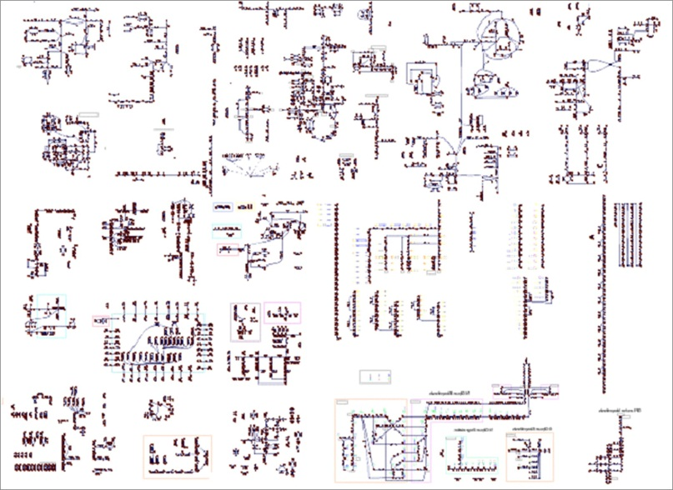
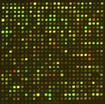



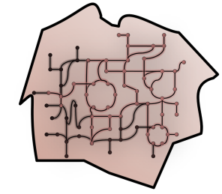
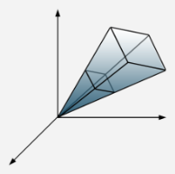

Reconstructing the genome-scale GBM metabolic network
Human Recon 1: Global metabolic network map
GBM-specific expression data
Model building algorithm (MBA)
Reduced, GBM-specific draft metabolic network
Metabolomics profiling of U-87 GBM cell lines
In silico model simulations & network analysis
Iterative gapfilling & refinement
23
Notes:
Overview of the process for reconstructing the GBM metabolic network
After generating draft network from MBA, iteratively refine using model simulations and metabolomics profiling

Slide 44




Metabolomics profiling of GBM will aid model refinement
Metabolomics profiling in U-87 cell lines for various conditions
Defined media (i.e., substrates)
Specific mutations
Multiple time points in cell cycle
Qualitative metabolomics to identify compounds not present in reconstructed network
Gapfilling (i.e., missing reactions, pathways)
Validation (i.e., confirm model functionality)
24
Notes:
Metabolomics profling to be performed using U-87 cell lines under various conditions to provide data for comparison with model simulations
Will initially perform qualitative metabolomics (presence) to aid in gapfilling and validation

Slide 45



Simulating and evaluating GBM network model
Constraint-based modeling used to evaluate capabilities and properties of metabolic networks
Metabolic reaction
Stoichiometric matrix
Physico-chemical constraints
Bounded solution space
Mass conservation:
Sv = 0
Reaction flux bounds:
v ≤ v_{max}
Thermodynamics, regulatory constraints
Price, N.D. et al. Nat Rev Microbiol (2004)
25
Notes:
Constraint-based analysis restricts functional states of a network according to PC laws, known stoichiometric relationships, and other constraints
Linear algebra and optimization tools used to determine steady-state flux distribution, given defined cellular objective; in this case, we assume optimal growth (characteristic phenotype in many cancers)
Simulate in variety of conditions, compare to experimental measurements from U-87 cell lines to validate and refine the model as needed

Slide 46
Simulating and evaluating GBM network model
Constraint-based modeling used to evaluate capabilities and properties of metabolic networks
Metabolic reaction
Stoichiometric matrix
Physico-chemical constraints
Bounded solution space
Mass conservation:
Sv = 0
Reaction flux bounds:
v ≤ v_{max}
Thermodynamics, regulatory constraints
Simulate model growth in variety of genetic & environmental conditions
Compare to experimentally measured growth rates, knock-out effects, secretion rates, etc.
Price, N.D. et al. Nat Rev Microbiol (2004)
25
Notes:
Constraint-based analysis restricts functional states of a network according to PC laws, known stoichiometric relationships, and other constraints
Linear algebra and optimization tools used to determine steady-state flux distribution, given defined cellular objective; in this case, we assume optimal growth (characteristic phenotype in many cancers)
Simulate in variety of conditions, compare to experimental measurements from U-87 cell lines to validate and refine the model as needed

Slide 47





Summary of Specific Aim 2
Accomplished: Implemented Matlab version of Model Building Algorithm (MBA) to generate draft metabolic network of GBM, based on evidence from protein and gene expression data
Next steps: Metabolomics profiling—along with manual curation—will be used to further refine GBM metabolic network
Next steps: Experimental studies with the U-87 GBM cell, in conjunction with in silico model simulations, will be used to assess predictive accuracy of the metabolic model
26

Slide 48
Specific Aim 3: Provide mechanistic and functional context for high-throughput mutation and expression data in GBM using the metabolic model
Applying network expression analysis tools to the GBM metabolic network to identify perturbed pathways
Investigating the distribution and effects of mutations in the GBM metaoblic network

Slide 49


Identifying perturbed metabolic pathways in GBM
Functional metabolic pathway groups
Expression data from GBM samples & normal astrocytes
High-confidence metabolic pathways
DIRAC & Adaptive DIRAC
NF-TSP & NF-DIRAC
Perturbed networks & network families in the GBM metabolic network
27
Notes:
Operating on high-confidence pathways in the GBM metabolic network, network-level analysis tools should produce more robust and mechanistically relevant results
Map expression data for GBM and normal samples onto metabolic pathways (e.g., glycolysis, TCA cycle); pathways can be naturally grouped into larger networks according to function (e.g., energy metabolism, nucleotide synthesis)
Perturbed pathways identified will also serve as focal point for simulations and model development

Slide 50

Investigating mutations in GBM using the model
Data from The Cancer Genome Atlas (TCGA) for several hundred GBM tumors: sequence, copy number, methylation, expression data; also RNAseq data for U-87 collected in lab
Distribution of mutations in GBM differs in each patient; will map mutation frequencies onto metabolic pathways to identify commonly perturbed processes
28
Notes:
Wealth of GBM mutation data, in many case matched with copy number, methylation, and expression data available through TCGA; RNAseq data collected from our lab will also be examined
Distribution of mutations in GBM has been shown to differ from patient to patient; examining frequency of mutations in metabolic pathways of the model, may be able to identify functional sets of genes that are consistently altered
Map mutation data onto corresponding enzymes in GBM network, apply statistical tests for enrichment of over-representations to identify key subnetworks
Can also simulate the effect of specific mutations that have been reported for GBM or other cancers (i.e., loss of function, gain of function); can also impose constraints to measure qualitiative effects of perturbations in signaling or regulatory pathways

Slide 51

Investigating mutations in GBM using the model
Data from The Cancer Genome Atlas (TCGA) for several hundred GBM tumors: sequence, copy number, methylation, expression data; also RNAseq data for U-87 collected in lab
Distribution of mutations in GBM differs in each patient; will map mutation frequencies onto metabolic pathways to identify commonly perturbed processes
Simulate the effect of specific mutations (i.e., loss of function, gain of function) in metabolic genes on network phenotypes
28
Notes:
Wealth of GBM mutation data, in many case matched with copy number, methylation, and expression data available through TCGA; RNAseq data collected from our lab will also be examined
Distribution of mutations in GBM has been shown to differ from patient to patient; examining frequency of mutations in metabolic pathways of the model, may be able to identify functional sets of genes that are consistently altered
Map mutation data onto corresponding enzymes in GBM network, apply statistical tests for enrichment of over-representations to identify key subnetworks
Can also simulate the effect of specific mutations that have been reported for GBM or other cancers (i.e., loss of function, gain of function); can also impose constraints to measure qualitiative effects of perturbations in signaling or regulatory pathways

Slide 52




Summary of Specific Aim 3
Operating on high-confidence pathways in the GBM metabolic network, DIRAC and NF-RXA should produce more robust and mechanistically relevant results
Investigating mutations in context of the GBM metabolic network to identify consistently mutated pathways and elucidate effects of specific mutations
29

Slide 53
Plan for Completion of Thesis
Projected timeline
Expected publications

Slide 54
Projected timeline
30

Slide 55
Expected publications
Published
Chavali, AK, Whittemore, JD, Eddy, JA, et al.. Systems analysis of metabolism in the pathogenic trypanosomatid Leishmania major. Mol Syst Biol (2008).
Lee, JM, Gianchandani, EP, Eddy, JA, Papin, JA. Dynamic analysis of integrated signaling, metabolic, and regulatory networks. PLoS Comp Biol (2008).
Milne, CB, Kim, PJ, Eddy, JA, Price, ND. Accomplishments in genome-scale in silico modeling for industrial and medical biotechnology. Biotechnol J (2009).
Eddy, JA, et al.. Relative expression analysis for molecular cancer diagnosis and prognosis. Conf Proc IEEE Eng Med Biol Soc (2009).
Eddy, JA, et al.. Identifying tightly regulated and variably expressed networks by Differential Rank Conservation (DIRAC). PLoS Comp Biol (2010).
Yang, J, Eddy, JA, et al.. Integrated proteomics and genomics analysis reveals a novel mesenchymal to epithelial transition in leiomyosarcoma through regulation of slug. Mol Cell Proteomics (2010).
Edelman, LB, Eddy, JA, Price, ND. In silico models of cancer. WIRES Syst Biol Med (2010).
Magis, AT, Earls, JC, Ko, YH, Eddy, JA, Price, ND. Graphics processing unit implementations of relative expression analysis algorithms enable dramatic computational speedup. Bioinformatics (2011).
31

Slide 56
Expected publications
Submitted
Milne, CB, Eddy, JA, et al.. Metabolic network reconstruction and genome-scale model of butanol-producing strain Clostridium beijerinckii NCIMB 8052. Submitted to BMC Syst Biol.
Writing stage (or later)
Chandrasekaran, S, Ament, SA, Eddy, JA, et al.. Brain Transcriptional Regulatory Network Quantitatively Predicts Behavior-Specific Gene Expression. Pending submission to Nature.
Earls, JC, Eddy, JA, et al.. AUREA: Accurate and user friendly disease classification. Target journal: BMC Bioinformatics.
Hadidi, B, Eddy, JA, et al.. Adaptive interaction-network based DIRAC. Target journal: BMC Bioinformatics.
Eddy, JA, et al.. Relative expression analysis of network families. Target journal: BMC Syst Biol.
In preparation
Wang, C, Funk, CC, Eddy, JA, et al.. Systems analysis of astrocytoma progression.
Eddy, JA, et al.. Reconstruction and analysis of the first genome-scale metabolic network of glioblastoma multiforme.
Future work
Eddy, JA, et al.. Identifying perturbed metabolic pathways in glioblastoma multiforme using network-level expression analysis tools.
Eddy, JA, et al.. Investigating the distribution and effects of mutations in glioblastoma multiforme with a genome-scale metabolic model.
32

Slide 57

Acknowledgments
Research Group for Computational & Systems Biology
Advisor
Nathan D. Price
Collaborators
Don Geman
Johns Hopkins University
Gene Robinson
University of Illinois
Lee Hood
Institute for Systems Biology
Post-docs
Nicholas Chia
Cory Funk
Pan-Jun Kim
Younhee Ko
Charu Gupta Kumar
Vineet Sangar
Graduate students
Jaeyun Sung
James Eddy
Caroline Milne
Sriram Chandrasekaran
Matthew Gonnerman
Andrew Magis
Chunjing Wang
Daniel Baker
Matthew Benedict
Piyush Labhsetwar
Shuyi Ma
Yuliang Wang
John Earls
Matthew Richards
Bozenza Sawicka
Seyfullah Kotil
Undergraduate students
Austin Lee-Richerson
Bobak Hadidi
Funding
Luxembourg Systems Medicine
Roy J. Carver Charitable Trust
NIH / National Cancer Institute

Slide 58
Mapping expression of genes into networks
Gene expression matrix
N samples
 | n₁ | … | n_{N}
g₁ | X_{g,n} | …
… | … | … | …
g_{G} |  | …
Class A
G genes
Class B
X_{g,n} = expression of gene g in sample n
Fixed network, m
g₁
n₁ n₂ n₃ n₄ n₅
g₁
g₂
g₃
g₄
g₂
g₃
g₄
Expression matrix for network genes

Slide 59
Rank template: expected network ranking for a phenotype
n₁ n₂ n₃ n₄ n₅
Pairwise ordering:
g₁
g₂
g₃
g₄
X₁ < X₂
For each pair of genes, g_{i} and g_{j}:
IF X_{i} < X_{j} in the majority of class k samples, THEN the corresponding template component is 1;
Otherwise, the (i,j)^{th} template component is 0.
Class A rank template:
T^{(A,m)} =
X₁ < X₂ :
X₁ < X₃ :
X₁ < X₄ :
X₂ < X₃ :
X₂ < X₄ :
X₃ < X₄ :
^{(A,m)}
^{(A,m)}

Slide 60
Rank matching scores
n₁ n₂ n₃ n₄ n₅
IF X_{i} < X_{j} in sample n AND the class k template at (i,j) = 1
ELSE IF X_{i} > X_{j} in sample n AND the class k template at (i,j) = 0
Otherwise, mismatch.
g₁
g₂
g₃
g₄
THEN match;
Class A rank matching score in n₂ :
T^{(A,m)} =
X₁ < X₂ :
X₁ < X₃ :
X₁ < X₄ :
X₂ < X₃ :
X₂ < X₄ :
X₃ < X₄ :
X₁ < X₂ :
X₁ < X₃ :
X₁ < X₄ :
X₂ < X₃ :
X₂ < X₄ :
X₃ < X₄ :
match
match
mismatch
match
match
match
n₁ n₂ n₃ n₄ n₅
R^{(A,m)} =
Class A template matching scores in all samples

Slide 61
Rank conservation index
Rank conservation indices provide measure of stability for network ranking in a phenotype
n₁ n₂ n₃ n₄ n₅
R^{(A,m)} =
µ_{R}^{(k,m)} ≈ 1.0: highly ordered state; samples have very similar rankings
n₁ n₂ n₃ n₄ n₅
R^{(B,m)} =
µ_{R}^{(k,m)} ≈ 0.5: highly disorganized state; much variation among rankings

Slide 62

Network rank conservation in a single phenotype
11 network genes: 55 pairwise orderings of expression values

Slide 63

Network rank conservation in a single phenotype
Pairwise orderings among SET network genes in normal prostate samples

Slide 64



Tightly regulated and differentially regulated networks
Rank conservation (µ_{R}): 0.945
µ_{R}: 0.909
µ_{R}: 0.891
Notes:
Add more…

Slide 65

Rank difference scores for discriminating samples
Rank difference score (Δ) indicates relation of sample network ranking to phenotype network ranking
Sample more closely matches phenotype A:
Δ > 0
Sample more closely matches phenotype B:
Δ ≤ 0

Slide 66
Differential rank conservation across phenotypes
n₁ n₂ n₃ n₄ n₅
R^{(A,m)} =
R^{(B,m)} =
Rank difference score:
n₁ n₂ n₃ n₄ n₅
Δ^{(m)} =
Predicted class A
Predicted class B
IF Δ^{(m)} > 0, THEN class A;
Otherwise, class B.
Class prediction with the rank difference score:

Slide 67

Differential rank conservation of the MAPK network

